Slide 1
The Keys to Success in Our Online World – How Connected Are You?
Robert Lavery

Slide 2
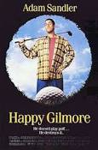
Memorable Movies in 1996?
“Show me the money!”
The Oscar for Best Picture?
The English Patient

Slide 3
Top 5 Songs in 1996?
5. Always Be My Baby – Mariah Carey
4. Nobody Knows – Tony Rich Project
3. Because You Loved Me – Celine Dion
2. One Sweet Day – Mariah Carey and Boyz II Men
1. Macarena (Bayside Boys Remix) – Los Del Rio

Slide 4
Sports Champions in 1996?
Stanley Cup – Colorado Avalanche
World Series – New York Yankees
Super Bowl – Dallas Cowboys
Grey Cup Winner – Toronto Argonauts

Slide 5
Olympic Gold in 1996
https://youtu.be/_Z64K8kznYs

Slide 6
What Life Was Like in 1996
Centennial Olympic Games held in Atlanta (Not Greece or Toronto)
Bill Clinton elected President of the United States. 2016 Hillary? Sorry, she got Trumped.
Interest Rate – 8.25% Average Cost of a New Home - $118K
Average Income - $36K - Min Wage - $5.15

Slide 7
BAASS Business 1996 Versus 2016
Number of Offices – 1 Now 21
Number of Employees – 4 Now 125
Number of Clients – 150 Now 4500
Annual Revenue – 6000% growth over 20 Years

Slide 8
From Humble Beginnings – 1st BC

Slide 9
1st BAASS Connect

Slide 10
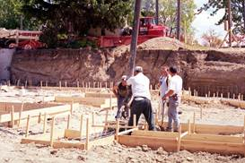
Really Humble Beginnings

Slide 11
BAASS Business Expands

Slide 12
New Building – Old Car

Slide 13
BAASS is a Full Service Company

Slide 14
BAASS is a Full Service Company

Slide 15
It’s Always About The People

Slide 16
Even Paraman!

Slide 17
It’s Still About The People

Slide 18
And The Food!

Slide 19
And About Giving

Slide 20
Significant News in 1996
Accpac International is created as a separate company.
Don Thomson returns to Accpac as VP of Research & Development. (Now runs TaiRox)
Accpac for Windows 2.0 is launched.

Slide 21
Changes in Technology Since 1996
DVD’s are launched in Japan.
Internet users exceed 10 Million. (3.2 Billion in 2015)
eBay starts doing business. Revenue of 17.9 Billion in 2014 (8.9 Billion in 2015)
1996 Microsoft only tech firm in top 10 market cap companies on the Dow Jones
2016 Top 5 market cap firms – Apple, Google, Microsoft, Amazon & Facebook

Slide 22
Phenomena of “Social” Media
“Social” – relating to society or its organization 1) Group, Community, Public, Popular
2) Gregarious
3) informal gathering
“Media” – the main means of mass communication – television, radio, newspapers and the Internet.
The influence of online technology led to Texting, Instagram, YouTube, Twitter, FaceBook
AND….

Slide 23
Online Meetings!
A Conference Call in Real Life
Please visit to see:
https://youtu.be/DYu_bGbZiiQ

Slide 24
Why Are Connections Important?
Our “Connections” affect the way we:
Learn & Make Decisions
Live & Relate To One Another
Love & Express Our Humanity

Slide 25
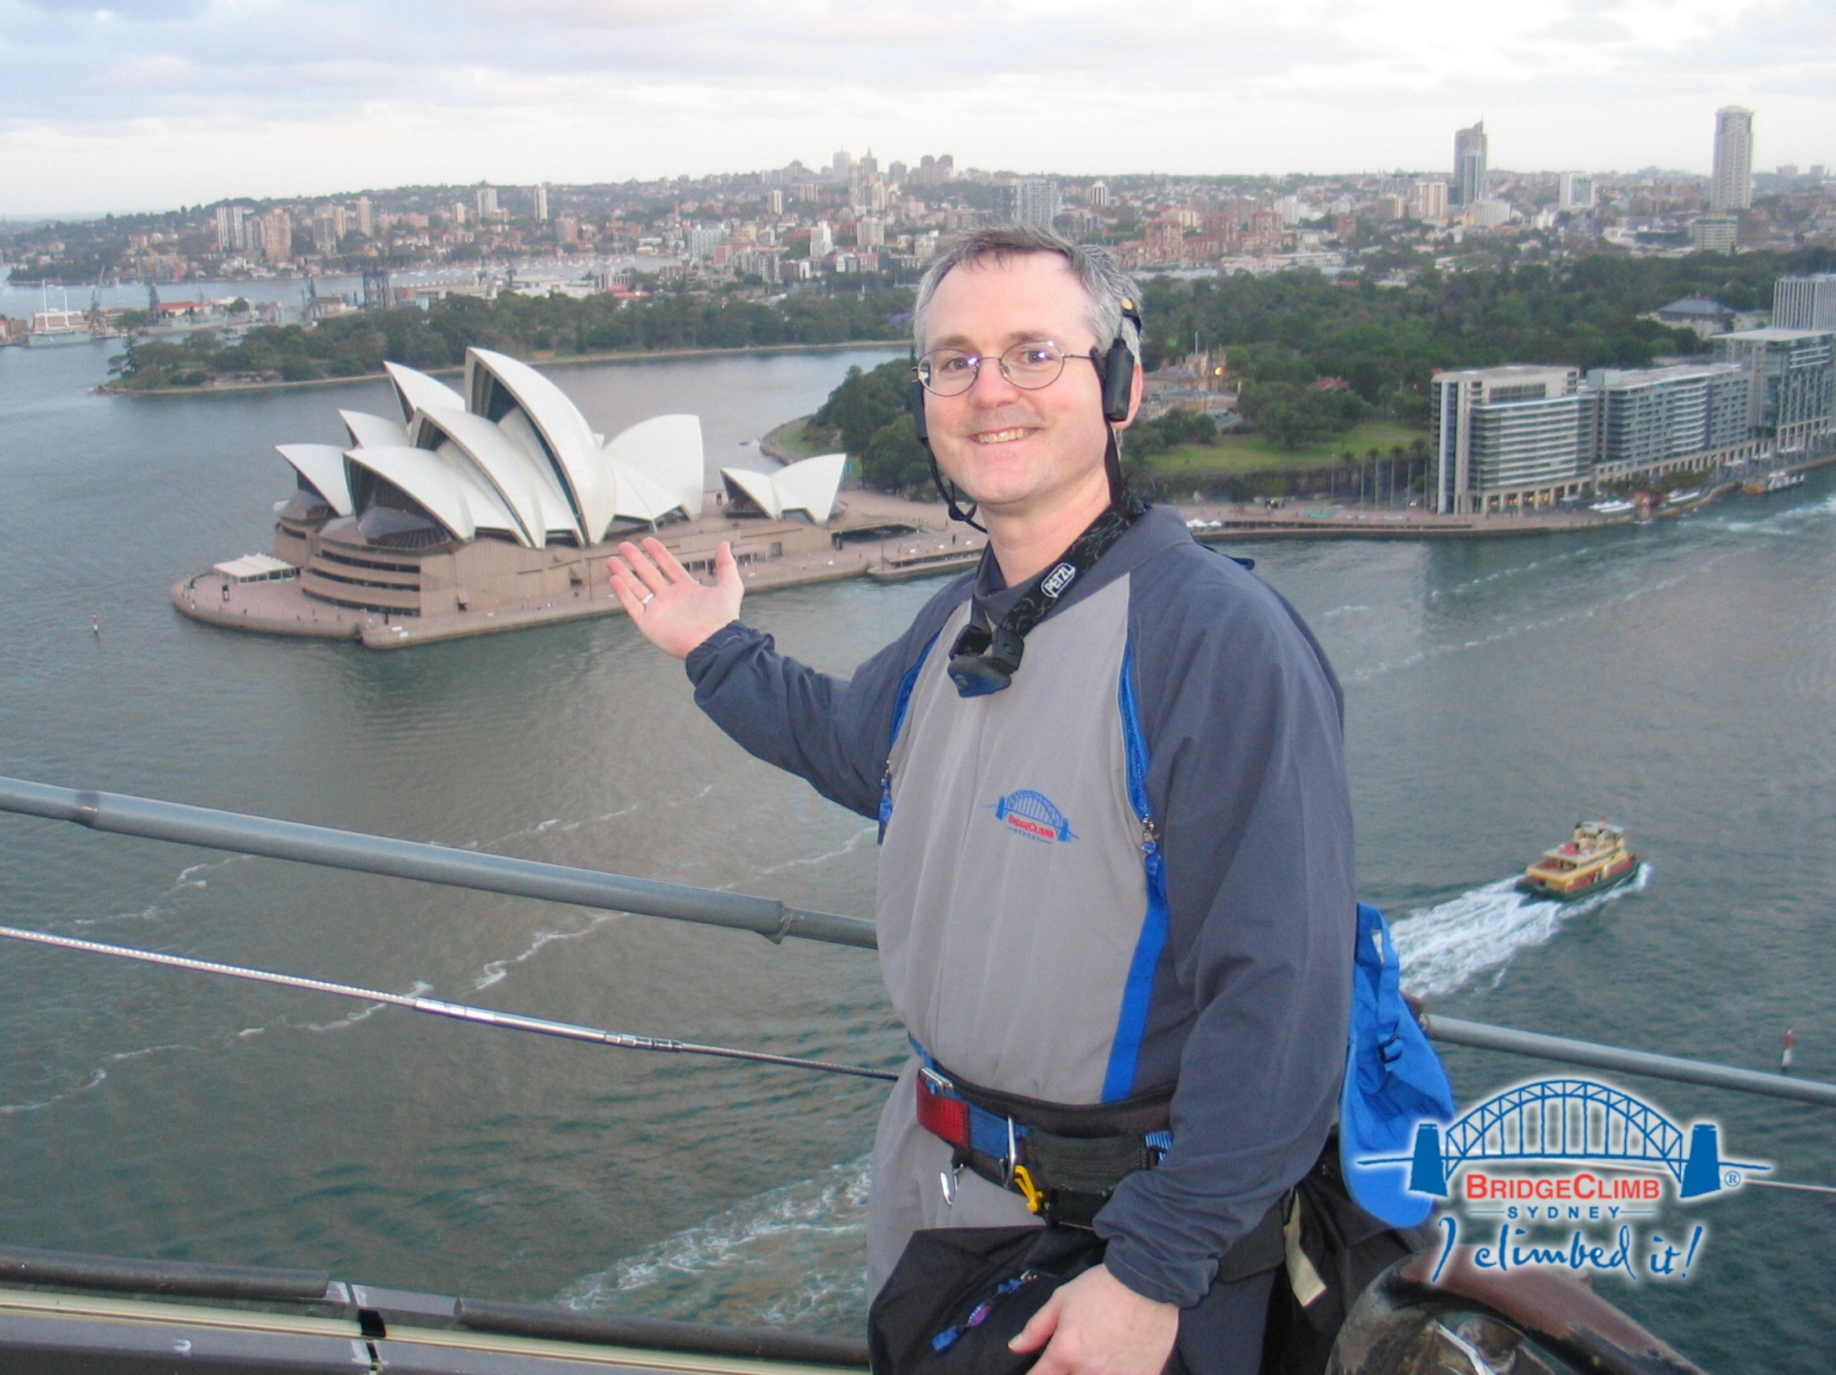

Slide 26
Significant Stories in 1996
“Into Thin Air”
May 10 Mount Everest Disaster kills 8 people – Rob Hall and Scott Fischer
Later in the afternoon, he radioed to Base Camp, asking them to call his wife, Jan Arnold, on the satellite phone. During this last communication, he reassured her that he was reasonably comfortable and told her, "Sleep well my sweetheart. Please don't worry too much." Shortly thereafter, he died
CGA EXACT Conference in Barbados – June 1996
Jamie Clark & Alan Hobson

Slide 27
Learning in a “Connected” World
The fallacy of multi-tasking
Brain works in a linear fashion.
Creating a generation of ADD People.
Screens versus Pages
The loss of mentorship – Apprentices
Power to relate affects achievement
Learn best from people we like.

Slide 28
The Great Technology Divide
The Era of selfies. (Dangerous to your health.)
Autonomous cars?
Online Meetings/Presentations
Privacy easier to obtain
Reduces our power to relate to one another

Slide 29
“How Success Happens”
David Brooks, lecture on “How Success Happens” at Rotman School of Management at U of T.
Based on his book “The Social Animal: The Hidden Sources of Love, Character and Achievement”
There is power in unconscious processes, power in our emotions and power in the interrelationships between people.

Slide 30
Relational Decision Making
Group IQ is not determined by the IQ of its members but how often they take turns conversing about the problem.
Requires emotional sensitivity to the opinions and feedback of group members.
Face to Face groups out perform Electronic or Online Groups. University of Michigan study

Slide 31
Living in a “Connected” World
70% of Employees don’t take vacation
85% of Young Adults spend 5 Hours per day online
47% up to 100 links, 36% up to 1000 links per day
20% Increase in accidents due to Driving & Texting
We are NOT autonomous creatures. We mimic each other. Ie Fashion
We eat more, the more people we eat with...
Enjoy Dinner “with” family and friends

Slide 33
Living in a “Connected” World
We fear failure more than we fear loss.
Tweet a walk in the park
Electronic Christmas Cards
Facebook fantasies
The Truth about Email Communication

Slide 34
Living in a “Connected” World
WORDS Do Matter:
A careless word may kindle strife,
A cruel word may wreck a life;
A timely word may lessen stress,
A loving word may heal and bless.

Slide 35
Love In a “Connected” World
Emoticons?
Impact of Online Pornography
Mobile Dating versus Online Dating
“Tinder & The Dawn of the Dating Apocalypse”
Loss of intimacy & fidelity/commitment
A culture of “Hook Ups”

Slide 36
Love in a “Connected” World
We depend on the 5 senses (sight, sound, smell, touch, taste) to determine who or what we like
Pillow talk
The importance of touch
Babies Need Touch – American Medical Journal May 2016
True Love Requires Head and Heart connection
The Wisdom of Dicky Fox – Jerry Maguire

Slide 37
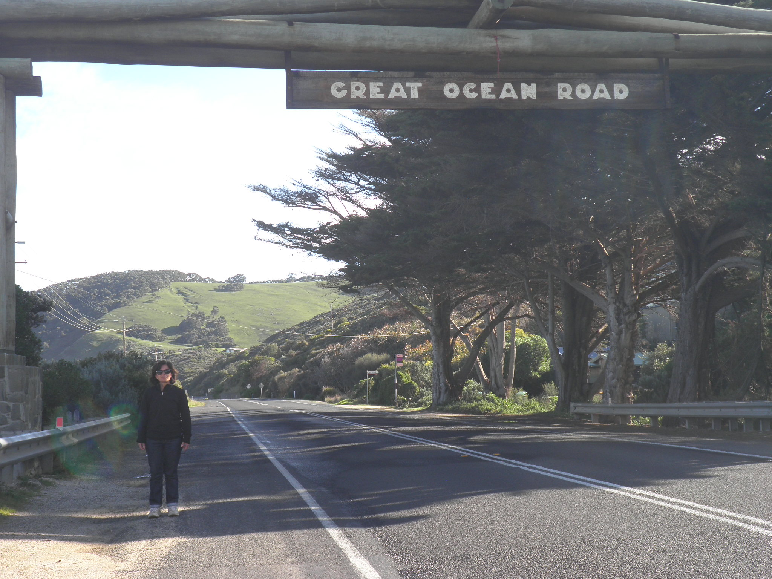

Slide 38
The Last Word
Dicky Fox: Hey, I don't have all the answers. In life, to be honest, I failed as much as I have succeeded. But I love my wife. I love my life. And I wish you my kind of success.

Slide 39
Thank You! Want To Connect?
Name: Robert Lavery
Email: Robert.lavery@sympatico.ca

