Slide 1
Payroll In-House or Outsource?
Presented By: Dan Papakonstantino

Slide 2
Opening Remarks
The focus of my session today…
To show the benefits of automating Time and Attendance which can make the decision to bring payroll in-house easier.
To discuss some of the differences between in-house and out-sourced payroll to help you determine which the best fit for your organization.

Slide 3
Opening Remarks
Important to note that…
As a developer of Time and Attendance software we integrate with both Sage 300 Payroll as well as out-sourced payroll service providers such as Ceridian and ADP.
And choosing an independent Time and Attendance solution gives you the freedom to choose the best payroll option for your organization.

Slide 4
Agenda
Time Capture Options
Pre-payroll Processing
Integration & Information Flow
Benefits of In-house vs. Out-sourced

Slide 5
Automating Time & Attendance
Our experience has shown that the majority of pain, effort and time in processing payroll comes from pre-payroll processing functions such as:
  Time capture and cost centre or Job allocation
  Calculations such as OT, Stat, shift-differential premiums and union rate calculations
  Lack of integration with HRMS and Time and Attendance software
  Manual key entry

Slide 6
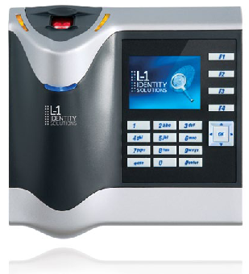
Time Capture
L1 Identity Finger Station
Finger Print Reader
RFID Card or Card-less
Buddy Punching

Slide 7
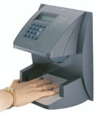
Time Capture
Allegion HandPunch
HandPunch
RFID Card/Card-less
Buddy Punching

Slide 8
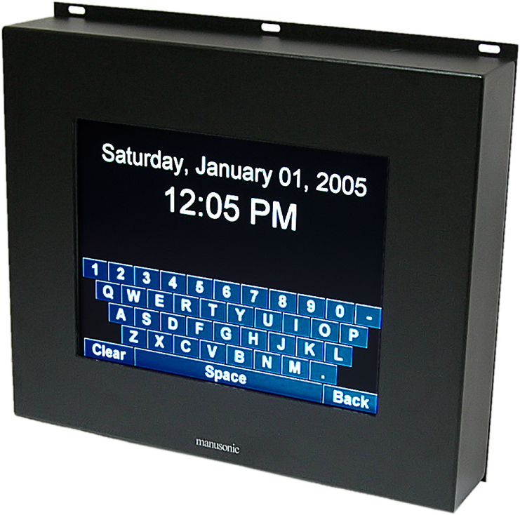
Time Capture
Manusonic SonicClock
RFID Access
Ruggedized Construction
Real-time access to
  Projects, Jobs and
  Manufacturing Orders

Slide 9
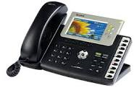
Time Capture
Sonic Phone Clock
Software Telephony
SIP Service Connectivity
Departments/ Function
Location Verification

Slide 10
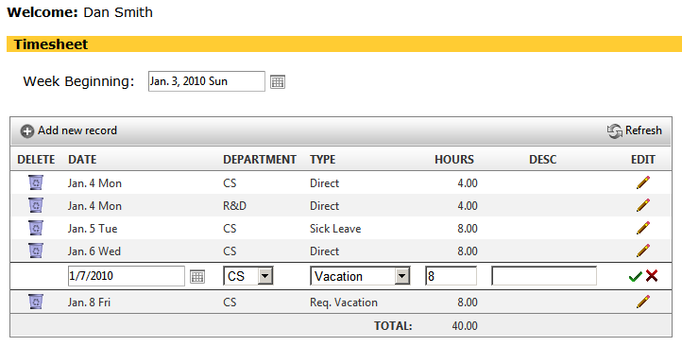
Time Capture
SonicWeb Time Sheet
Brower-based
Project Job Cost Integration
Sage HRMS Integration
Manager Approvals
Request for Vacation

Slide 11
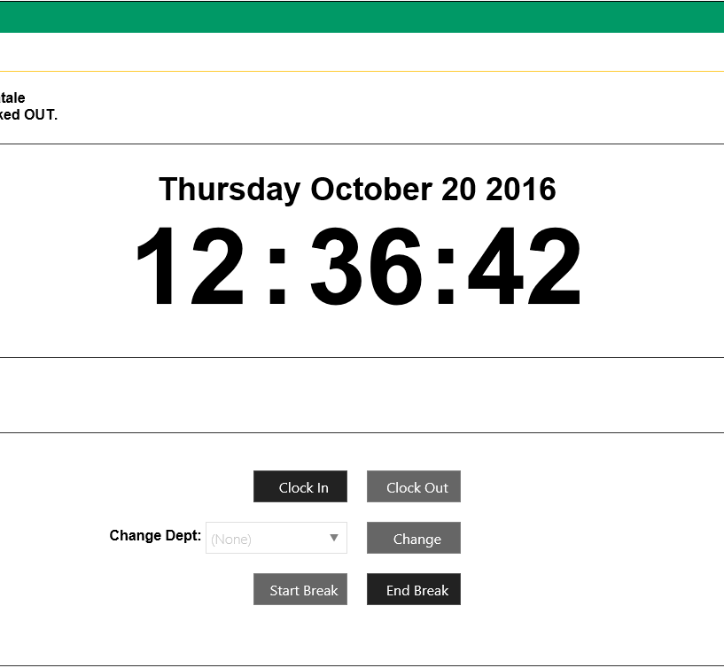
Time Capture
SonicWeb Clock
Browser-based
Desktop/ Laptop/ Table
Cost Centre, Project/ Job Labour Allocation

Slide 12
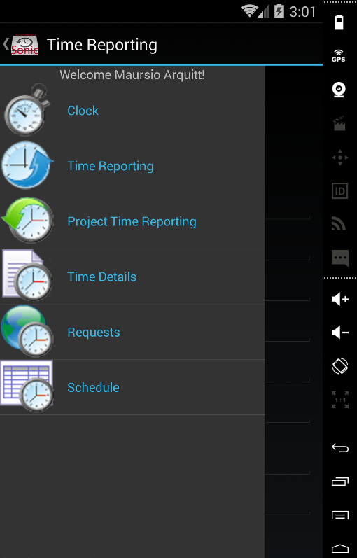
Time Capture
Sonic Mobile
Android/ Apple iOS
Timesheet Entry/ Start-Stop Clock
Project/ Job Labour Allocation
Scheduling Views/ Notifications
Geo-Tagging

Slide 13
Pre-payroll Processing
SonicEnterprise
Shift Management
Hour Rounding
Overtime Processing
Statutory Holiday Calculation
Union Rate Calculation
Manager Approval
Alerts

Slide 14
Integration
Manusonic
Time & Attendance
Employee Info - Time
Sage 300 ERP/ Payroll
Employee Info
Sage HRMS
Time Off

Slide 15
Information Flow
New hire information is entered in Sage HRMS
Employee details are electronically transferred to Sage Payroll and Manusonic Time and Attendance.
Employee time is captured, approved and processed in Manusonic.
Time worked transactions are transferred directly to Sage 300 Payroll timecard.
Time off transactions are transferred to Sage HRMS Attendance Plans.

Slide 16
Benefits of In-house Payroll
Integration with HR and Time and Attendance
Control
Better Reporting
Time savings
Cost savings
  Cost per pay cheque
  Admin fees
  Reports
  ROE
  T4

Slide 17
ROI Calculator
Out-sourced Payroll vs. In-house Payroll - 5 Year Cost Savings Analysis
Current Out-sourced Payroll Costs | Year 1 | Year 2 | Year 3 | Year 4 | Year 5 | 5 Year Total
Number of Employees w/ 3% yearly increase | 500 | 515 | 530 | 546 | 563
Number of Pay Periods | 26 | 26 | 26 | 26 | 26
Cost per Cheque/DD (w/ 3% inflactionary increase) | $2.50 | $2.58 | $2.65 | $2.73 | $2.81
ROE Charge ( based on 10% turnover w/ $4.00 fee) | $200.00 | $206.00 | $212.18 | $218.55 | $225.10
New Hire charge (based on 10% turnover w/ $4.00 fee) | $200.00 | $206.00 | $212.18 | $218.55 | $225.10
Yearly Report Charges | $500 | $500 | $500 | $500 | $500
T4 Charges ($5.00) | $2,500 | $2,060 | $2,122 | $2,185 | $2,251
EFT Charges (0.25) | $125 | $129 | $133 | $137 | $141
Miscellaneous Fees | $250 | $250 | $250 | $250 | $250
Total Current Payroll Costs | $36,275 | $37,830 | $40,008 | $42,316 | $44,762 | $201,191
Future In-house Payroll Costs | Year 1 | Year 2 | Year 3 | Year 4 | Year 5 | 5 Year Total
Proposed Payroll Software License Fees | 2,500
Implementation Cost | 5,000
Additional Fees (optional) | 0
Annual Software Support Fees (22% of Lic. Fees) | 550 | 550 | 550 | 550 | 550 | 2,750
EFT Charges by Bank (0.25) | 3,250 | 3,348 | 3,448 | 3,551 | 3,658 | 17,255
Future Internal Payroll Costs | $11,300 | $3,898 | $3,998 | $4,101 | $4,208 | $27,505
Savings | $24,975 | $33,933 | $36,010 | $38,214 | $40,554 | $173,686
 | 68.85% | 89.70% | 90.01% | 90.31% | 90.60% | 86.33%

Slide 18
Thank you

